Slide 1

Memcomb
Noah Bradley, Bryce Waters, Isaac Watson, Jizhou Zhang, Andrew Dever, Kyle King

Slide 2
Memcomb
For those who want to share and connect through similar memories in their lives. The Memcomb application is a social media platform that allows users to upload photos, videos, and audio, with an attached caption, that displays an important event in their lives. Unlike similar applications, Memcomb will connect users who share events of a similar time and place, allowing those users to discover each other. Our product provides a new way for users to interact with one another.

Slide 3
This Sprint
Documentation catch up
Updated signup page
Updated profile page
Displaying profile page images and saving the profile page’s data into database
Fixed SMTP issue
Set default page
Now displays all memories on to the timeline

Slide 4
Challenges and Risks
General working from home difficulties
Getting ALL group members to attend meetings
Getting the profile picture and background picture to stop overriding one another anytime one or the other is being uploaded
Working with partial views and multiple models within them
Debugging especially, due to so many connections between the MVC files
Modal popup issues with creating memories and viewing the uploaded memories

Slide 5
Mitigation Plan
Constantly debugging / setting breakpoints
Understanding how components work
Although the HTML/Javascript files do not allow breakpoints making it more difficult to see errors

Slide 6
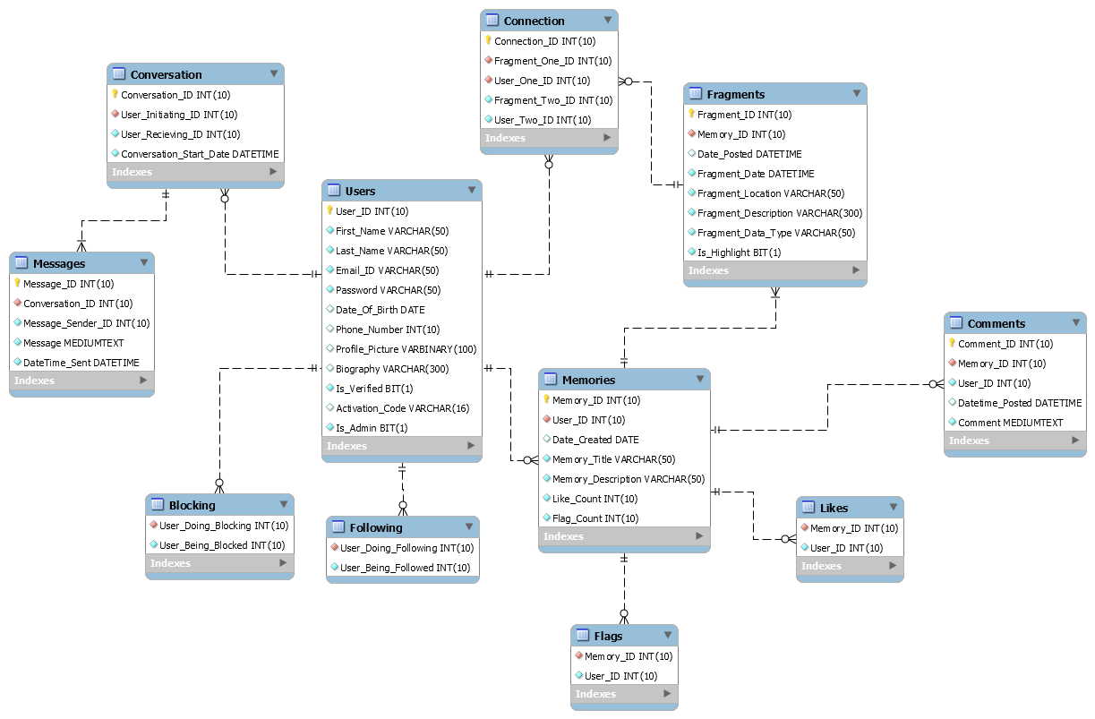
Current EERD

Slide 7
User Stories
This Sprint
As a user, I can upload and view my profile wallpaper
As a user, I can upload and view my profile picture
As a user, I can see memories on the timeline as well as creating new ones
Next Week
Begin wrapping up our project, final implementations, documentation, and final presentation.

Slide 8
Demo

